Slide 1
Synthesis and Data Assimilation
H. Heorton & P. Lewis

Slide 2
Bringing it all together
So far we have covered aspects of Terrestrial Carbon separately:
Plant traits and phenology
Modelling photosynthesis and DGVMs
Observations
Actual observations
The PEM approach
But how are these types of knowledge brought together?
How do they represent key aspects of Terrestrial Carbon?
Case studies
Data Assimilation

Slide 3
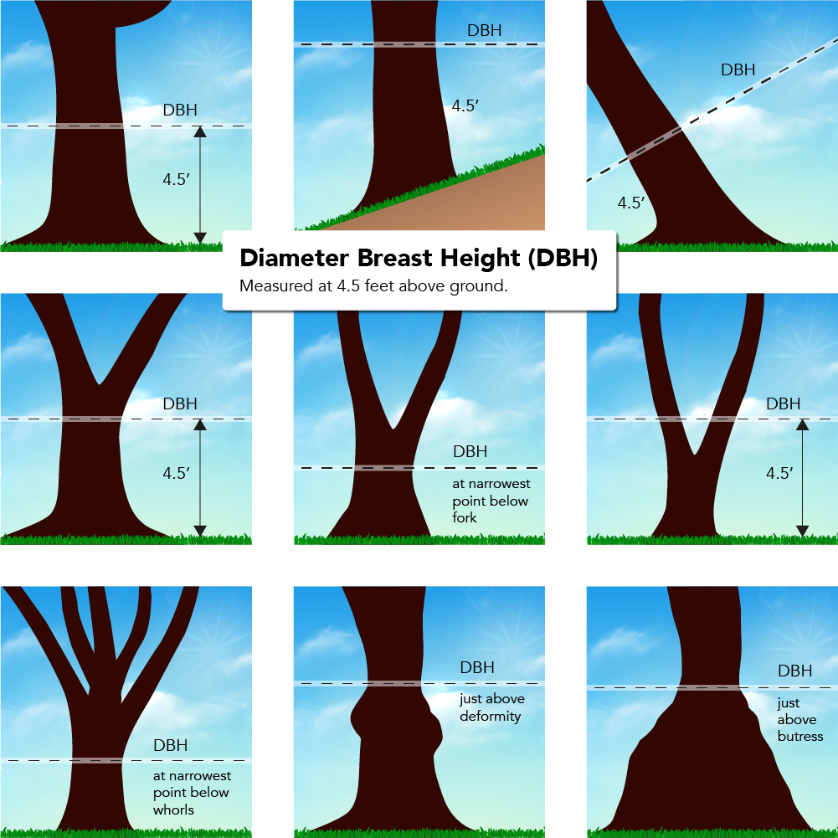
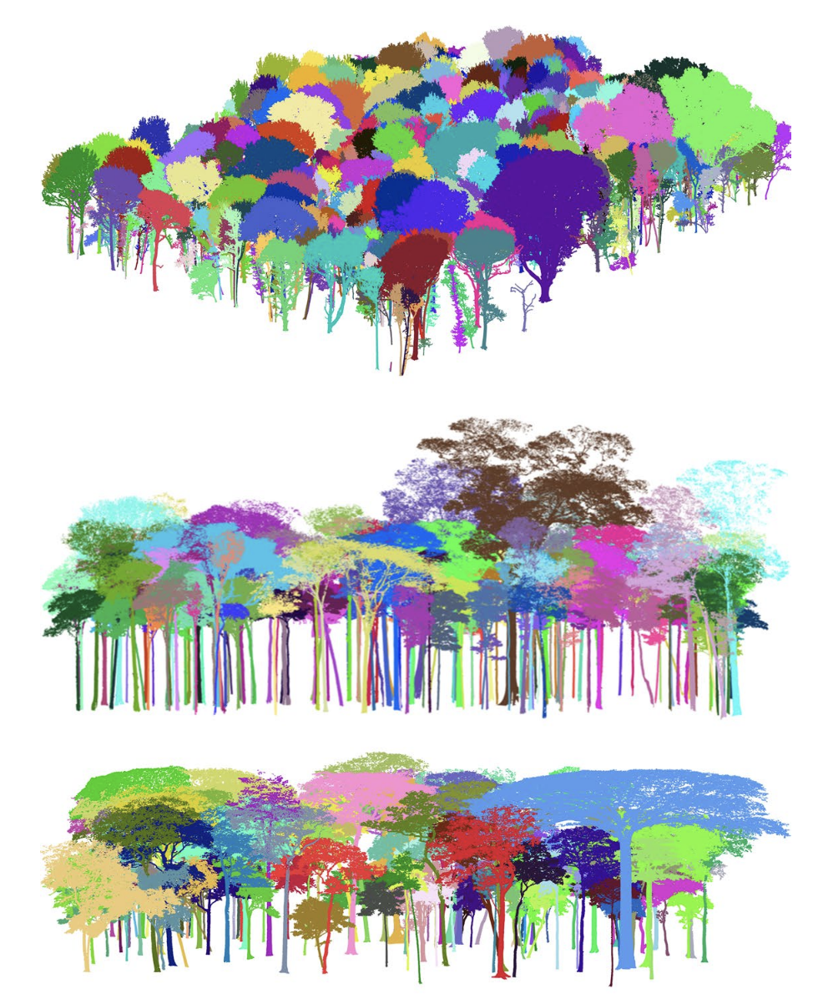
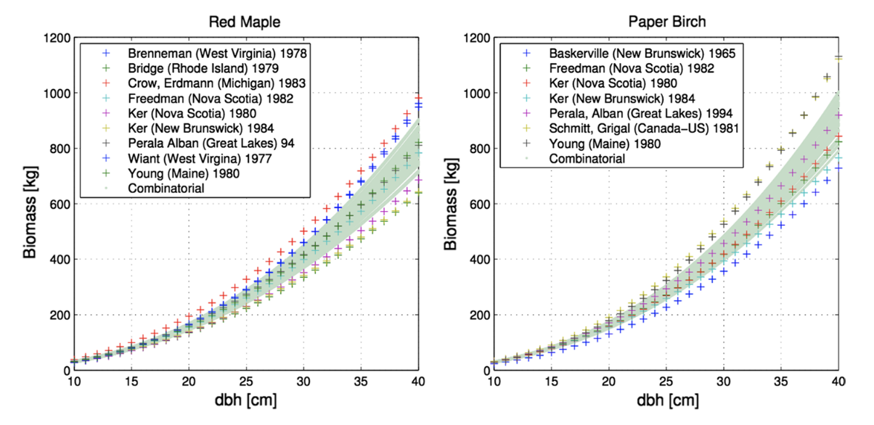
Case Study 1 – Forest Biomass
How to measure forest Biomass
- DBH (Diameter at Breast Height)
- TLS (Terrestrial Laser Scanning)

Slide 4
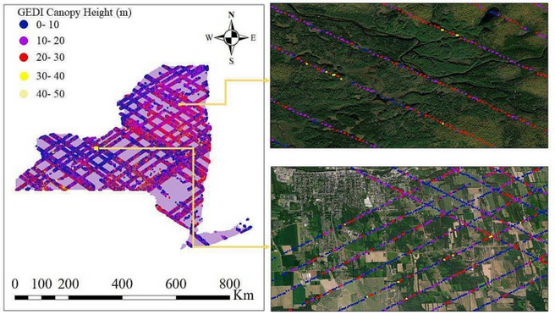
Case Study 1 – Forest Biomass
How to measure forest Biomass
Global scale
Utilising satellite altimetry – the GEDI instrument upon the ISS
While GEDI is shown to have good accuracy to ground truthing, it has now been used to train many AI models which have variable accuracy (but global coverage!)
https://www.earthdata.nasa.gov/data/projects/gedi

Slide 5
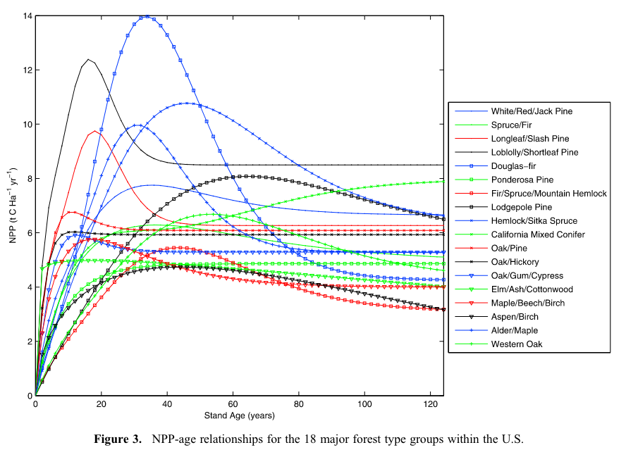
Case Study 1 – Forest Biomass
Lager trees are typically older, and have higher and more dense canopies with more photosynthetic potential
Complications
Species
Biome
Stand age

Slide 6
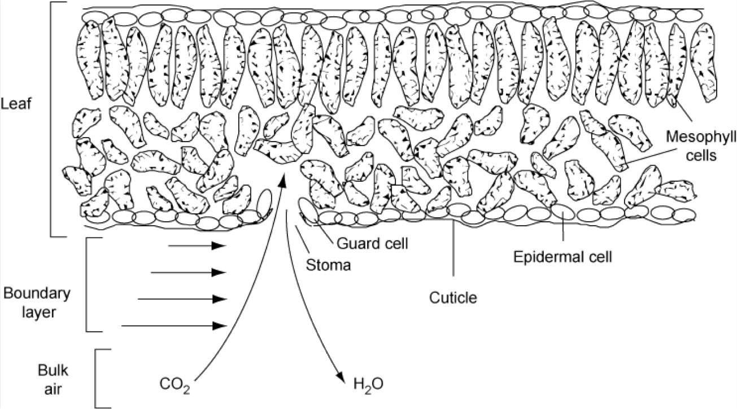
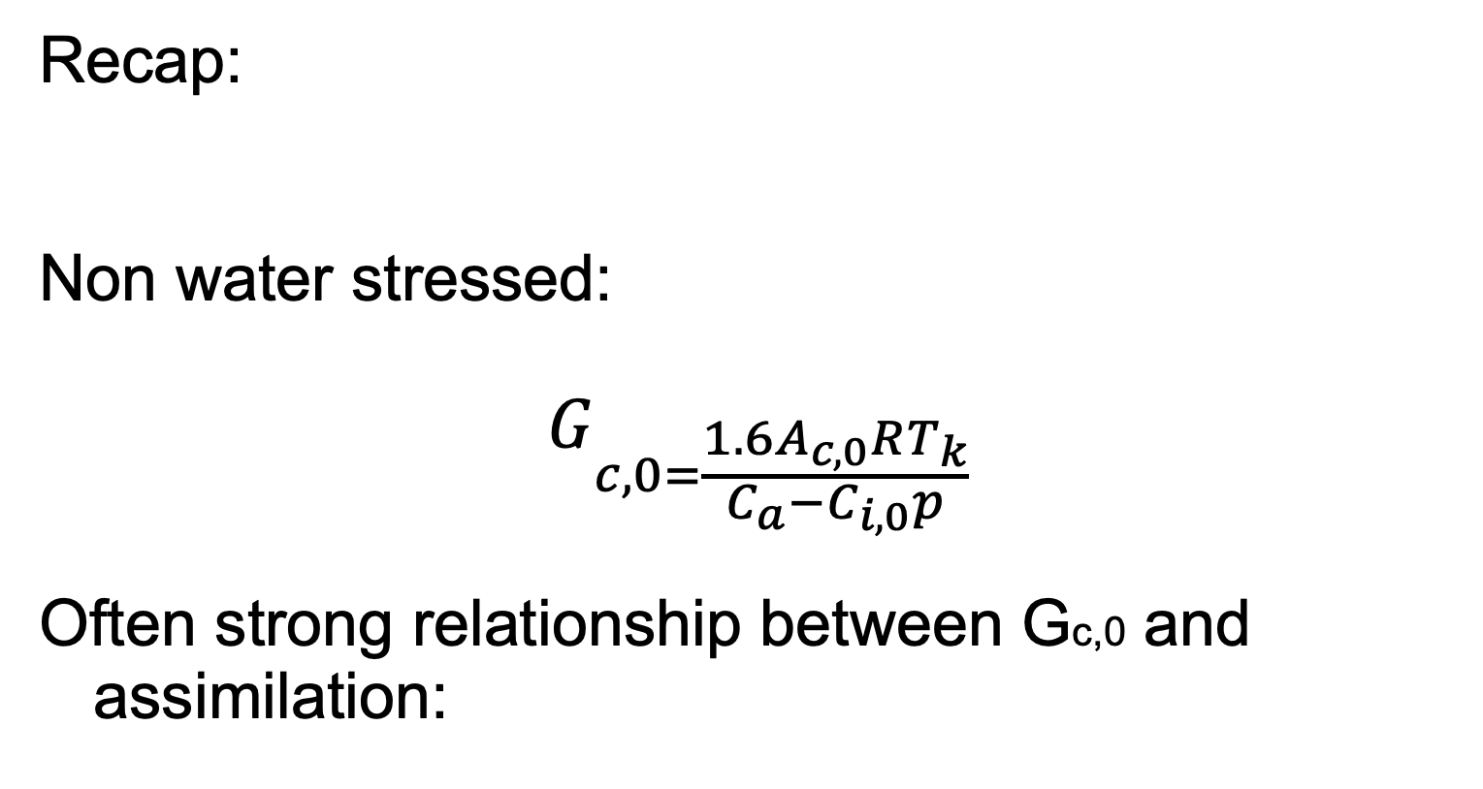
Case Study 2 – Stomatal Conductance
Recap:
Non water stressed:
$$G_{c,0=\frac{1.6A_{c,0}RT_{k}}{C_{a}−C_{i,0}p}}$$
Often strong relationship between Gc,0 and assimilation:
G_{c,0} = 0.883 A_{c,0}

Slide 7
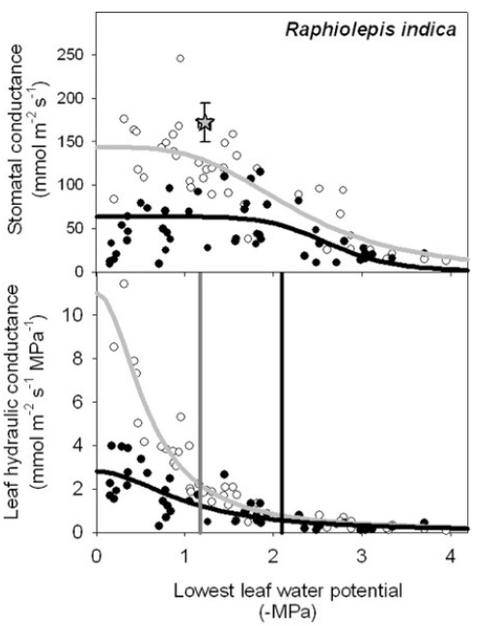
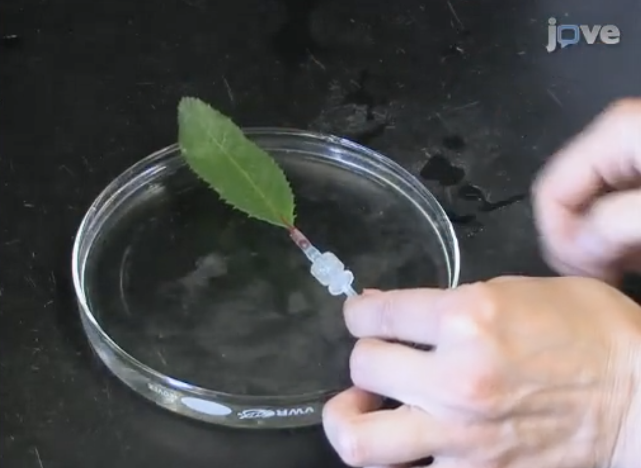
Case Study 2 – Stomatal Conductance
https://www.jove.com/v/4179/measurement-leaf-hydraulic-conductance-stomatal-conductance-their
The water content and flow rate can be measured in lab settings
This can be controlled for photosynthesis rates and leaf hydration to simulate water stress.

Slide 8
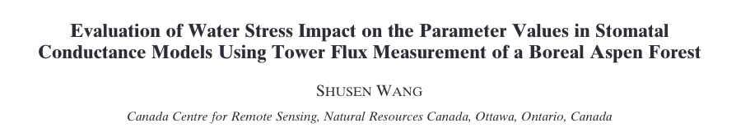
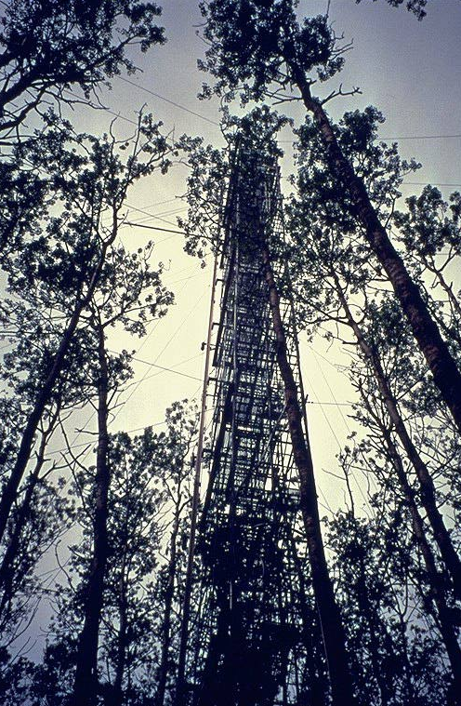
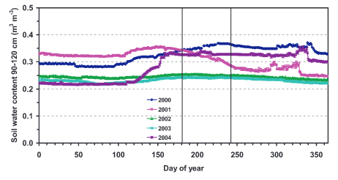
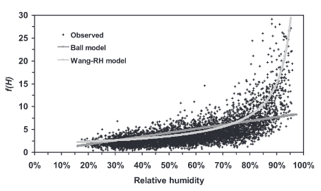
Case Study 2 – Stomatal Conductance
Scaling up from the lab to a single forest
Similarly to the lab setting we can estimate moisture in (from soil)
This can be related to flux tower measurements of Photosynthesis and humidity
The relationship between stomatal conductance, water stress and photosynthesis can then be constrained

Slide 9
Case Study 2 – Stomatal Conductance
Global “data”
PEM models often get described as data, why?
For large model intercomparison projects they are the data baseline, but still a model
They are more based on observed quantities than the free running DGVMs
The “observed” quantities will capture spatial and temporal variations, even if precise locational accuracy is limited

Slide 10
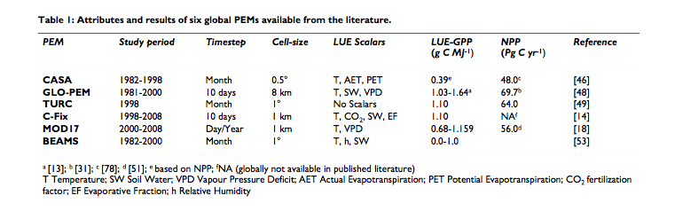
Some PEMs
Notes:
NB read see McCallum et al for review

Slide 11
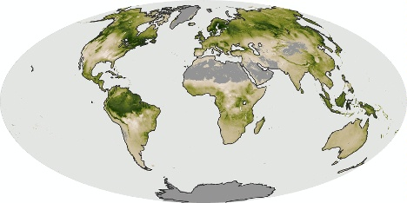
Going back to Lecture 003 NPP: July 2006 (MOD17 PEM)

Slide 12
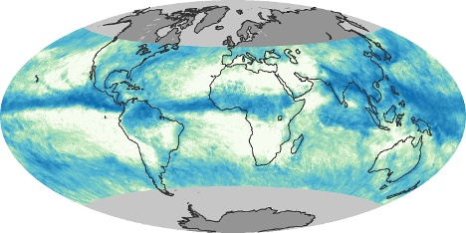
Precip.: July 2006

Slide 13
Data assimilation
What is DA?
What does DA do? Why do we do it?
What does it achieve?
Examples:
Toy model
General DA concepts
Quaife et al. 2008
Sequential technique – Kalman Filter
MacBean et al. 2018 (Orchidee, SIF)
Variational technique – using cost functions

Slide 14
Models and measurement
Suppose we have a model parameterized by state variables x
e.g. Vcmax, Tmin etc.
And the model that predicts some quantity y for given x
and driving variables, T, IPAR, …
e.g. y might be daily C flux
If we have some measurements of y, we want to use them to improve model prediction
How can we do that?

Slide 15
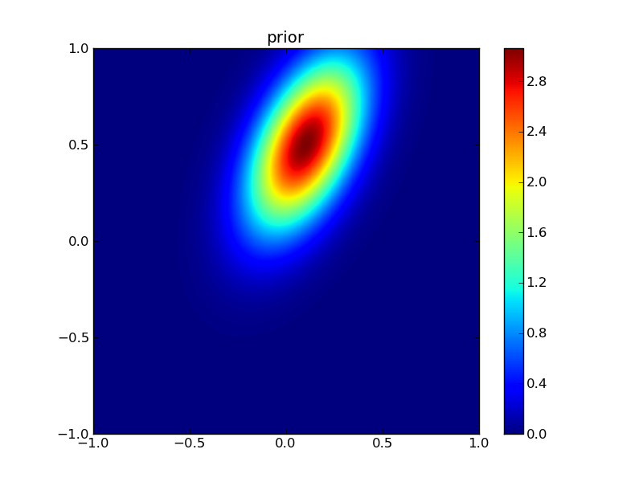
Toy model: ‘model inversion’ view
1. Take measurement of y
2. Given parameters x=[x₀,x₁], make model prediction of y, y_{hat}
x₁
3. Define and calculate discrepancy metric J=|y-y_{hat}|_{N}
4. Vary model parameters x, and calculate J at each point
x₀
5. Find ‘optimal’ solution, i.e. arg min_{x} (J)

Slide 16
What is Data Assimilation?
A set of techniques to combine data with some underlying process model to provide optimal estimates of the true state and/or parameters of that model.

Slide 17
What is Data Assimilation?
It is not just model inversion.
But could be seen as a process constraint on inversion (e.g. a temporal constraint)
https://climatedataguide.ucar.edu/climate-data/simplistic-overview-reanalysis-data-assimilation-methods

Slide 18
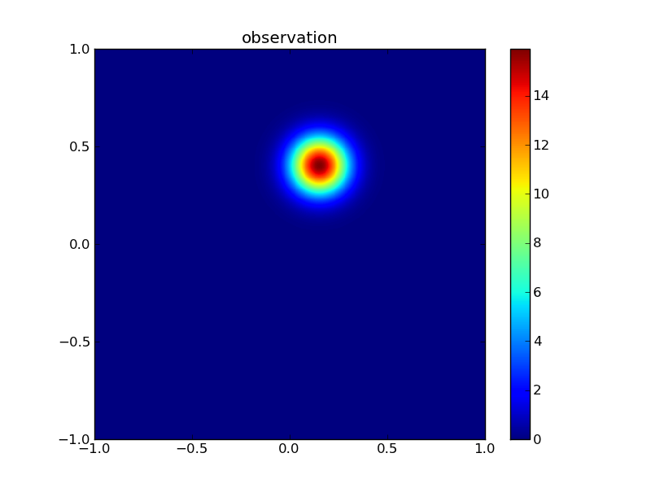
Toy model: Uncertainty
We must treat all information as uncertain
Define PDF for observations, parameters
Describe model uncertainty, driver uncertainty
And account for all of these

Slide 19
Data Assimilation is Bayesian
Bayes’ theorem:
P(A|B) | = | P(B|A) P(A)
 |  | P(B)
Intro to DA with EO : Lahoz & Schneider (2014)

Slide 20
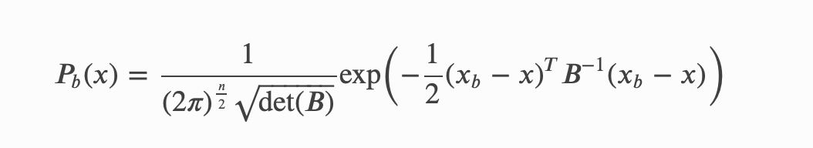

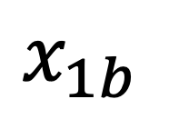
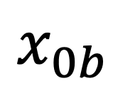

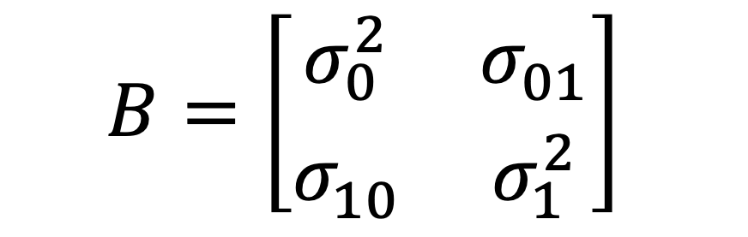
multivariate
Identify the terms here: B, n, x_{b}
$$x=\left[\begin{matrix}x_{0b} \\ x_{1b}\end{matrix}\right]$$
$$x_{b}=\left[\begin{matrix}{\overline{x}}_{0b} \\ {\overline{x}}_{1b}\end{matrix}\right]$$
$$x_{1b}$$
$$B=\left[\begin{matrix}σ_{0}^{2} & σ_{01}^{} \\ σ_{10}^{} & σ_{1}^{2}\end{matrix}\right]$$
$$x_{0b}$$

Slide 21


Slide 22
What does DA aim to do?
Use all available information about
A Priori information
The underlying model
The observations
The observation operator
Including estimates of uncertainty and the current state of the system
To provide a best estimate of the true state of the system with quantified uncertainty

Slide 23
Quaife et al. 2008
Quaife et al.
Seek to use EO observations
MODIS reflectance over time
To improve C flux estimates
Spatially
Approach:
Model of C flux (DALEC)
H(x) is radiative transfer for forests (GORT)
Kalman filter

Slide 24
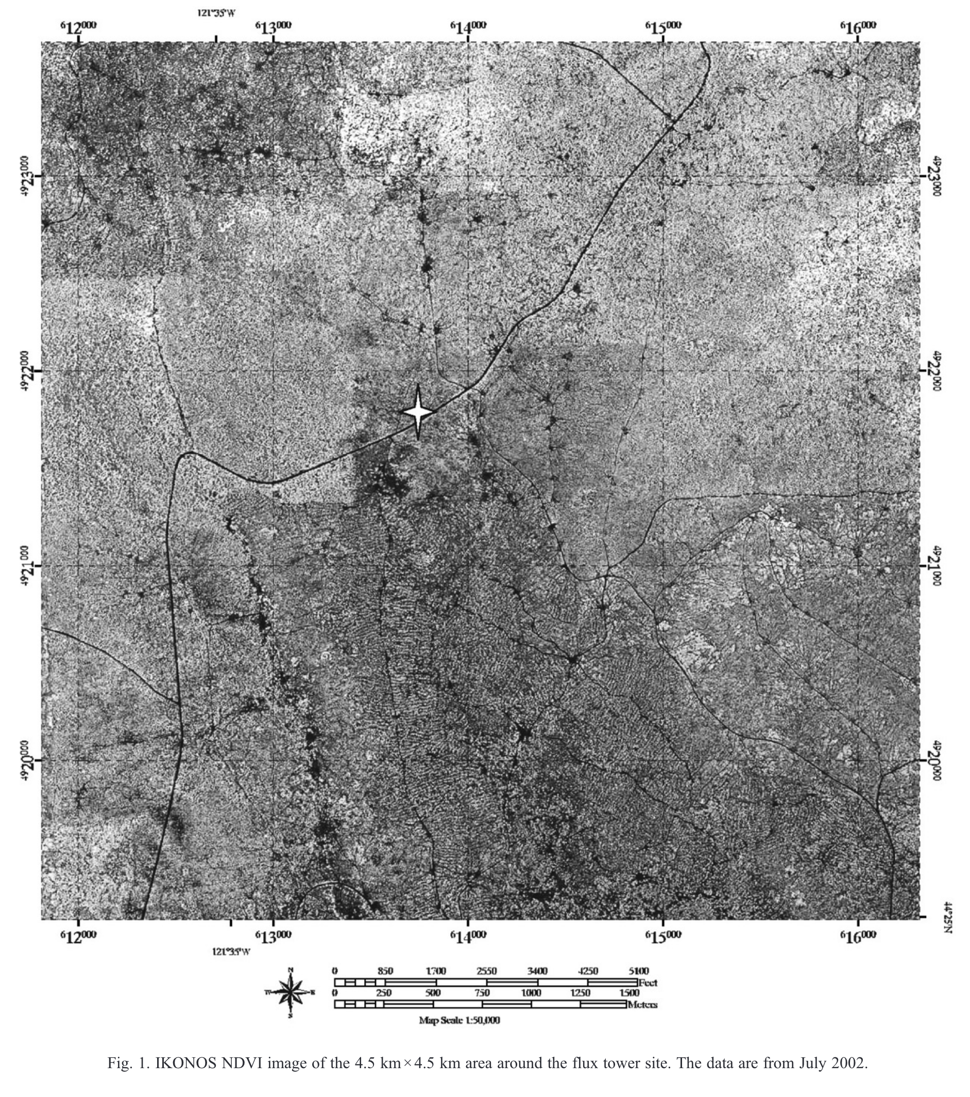
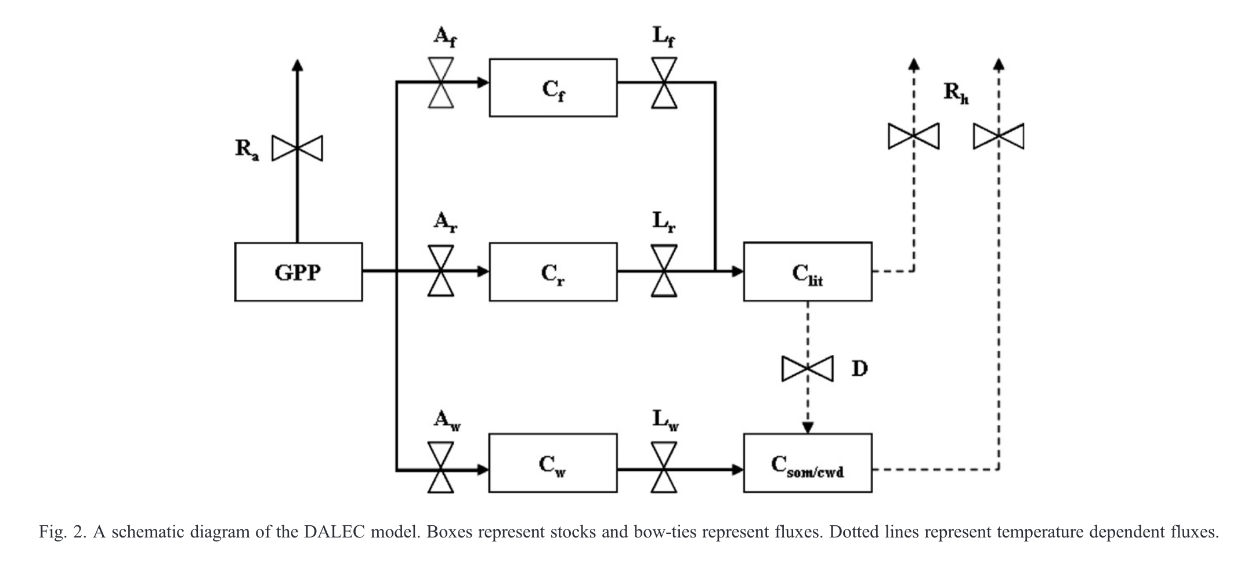
Quaife et al. 2008
We have regular satellite surface reflectance data
We can map surface reflectance to LAI (observation operator)
We have a model than includes this variable
There is additional data from a flux tower to validate against

Slide 25
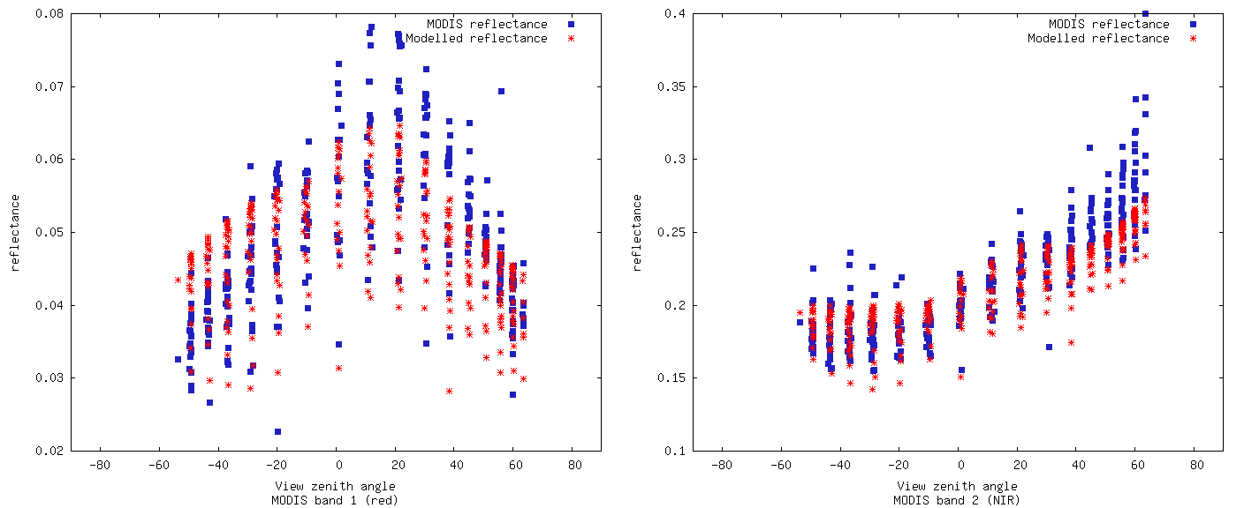
Quaife et al. 2008: Modelled vs. observed reflectance
Red
NIR
Note BRF shape in red: can’t simulate with 1-D canopy (GORT here)

Slide 26
Quaife et al. 2008: The Kalman Filter
Linear process model
Linear observation operator
Assumes normally distributed errors

Slide 27
Quaife et al. 2008: The Kalman filter
Propagation step:
x = Mx⁻
P = MP⁻M^{T} + Q
Analysis step:
x* = x + K( y – Hx )
K = PH^{T}( HPH^{T}+R )⁻¹
Observation operator
Model
Covariancematrix
Stochastic forcing
Kalman gain
Observation covariance matrix
State vector
Observation vector

Slide 28
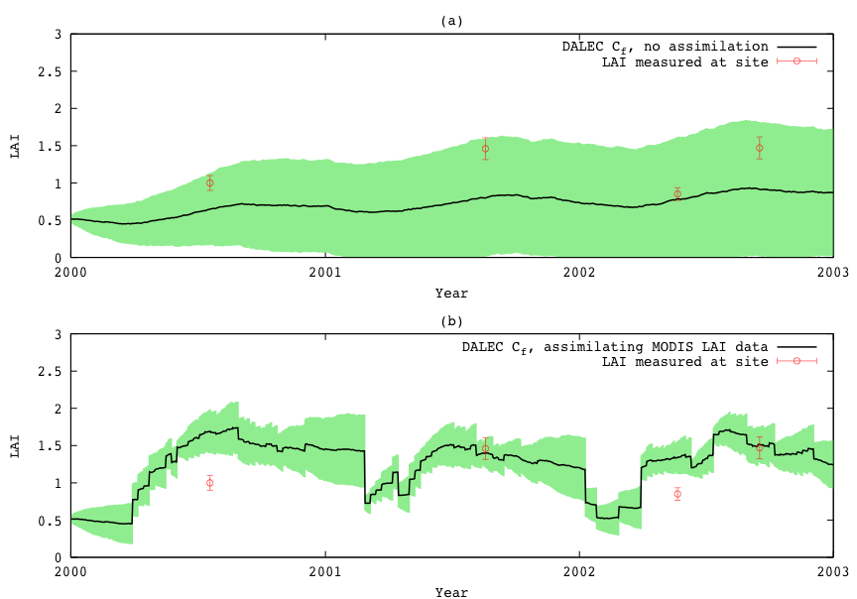
Quaife et al. 2008: Kalman Filter DA
Data assimilation into DALEC ecological model: Quaife et al. 2008

Slide 29

Quaife et al. 2008: Mean NEP for 2000-2002
EO data: spatial DA
Flux Tower
4.5 km
Spatial average = 50.9
Std. dev. = 9.7
(gC/m²/year)
15
65
gC/m²/year

Slide 30
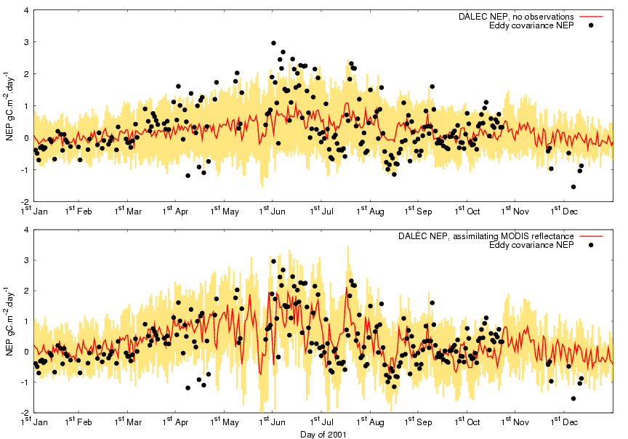
Quaife et al. 2008: The Ensemble Kalman Filter
No assimilation
Assimilating MODIS surface reflectance bands 1 and 2

Slide 31
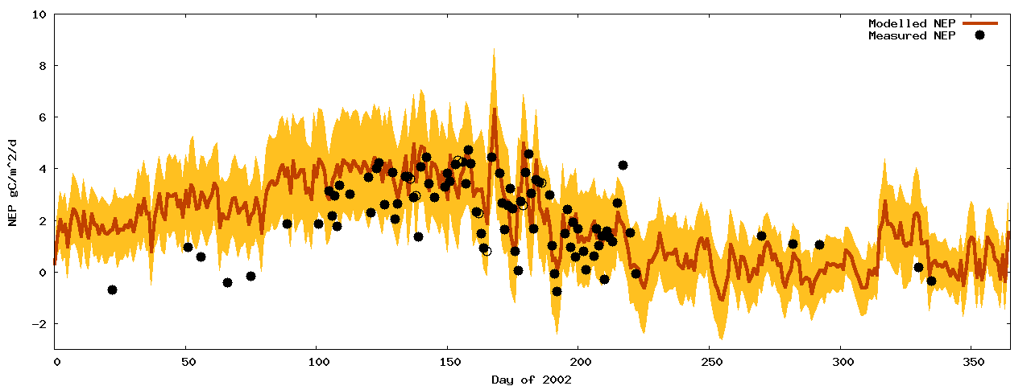
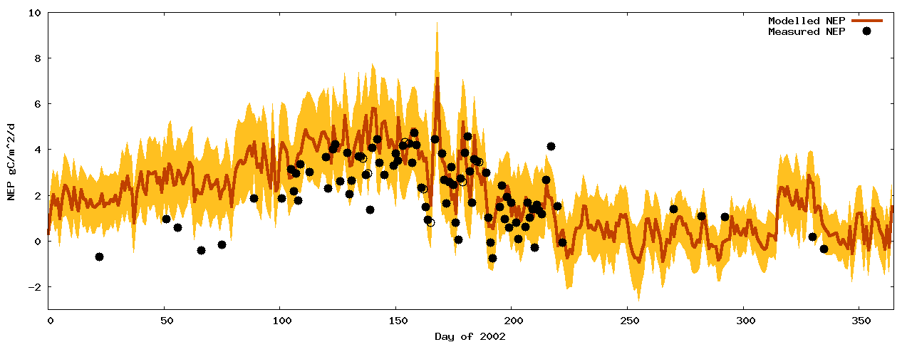
Quaife et al. 2008: NEP – Site2 (intermediate) parameters, with/without DA
Model running at Site 2, Oregon
Site 1 model EO-calibrated at site 2 NEP observations from Site 2
Shows ability to spatialise

Slide 32
MacBean et al. 2018: Particle Filters
Propagation step:
X = m(X⁻) + Q
Analysis step:
e.g. Metropolis-Hastings

Slide 33
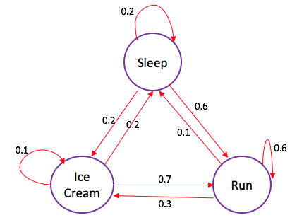
Markov Chain
Markov Process
probability of each event depends only on the state attained in the previous event.
Markov Chain
A countably infinite sequence, in which the chain moves state at discrete time steps, gives a discrete-time Markov chain (DTMC)

Slide 34
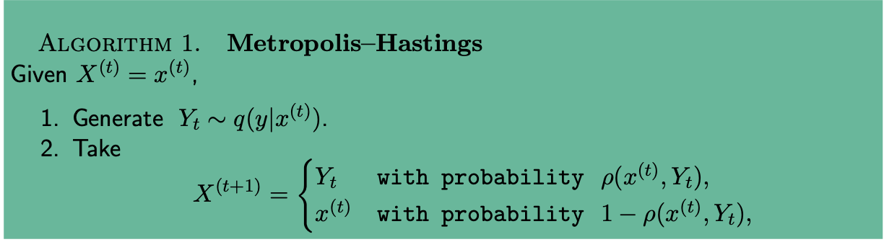

MacBean et al. 2018: Particle Filters
Consider transition from X(t) to X(t+1)
q: proposal kernel
Acceptance ratio
https://arxiv.org/pdf/1504.01896.pdf

Slide 35
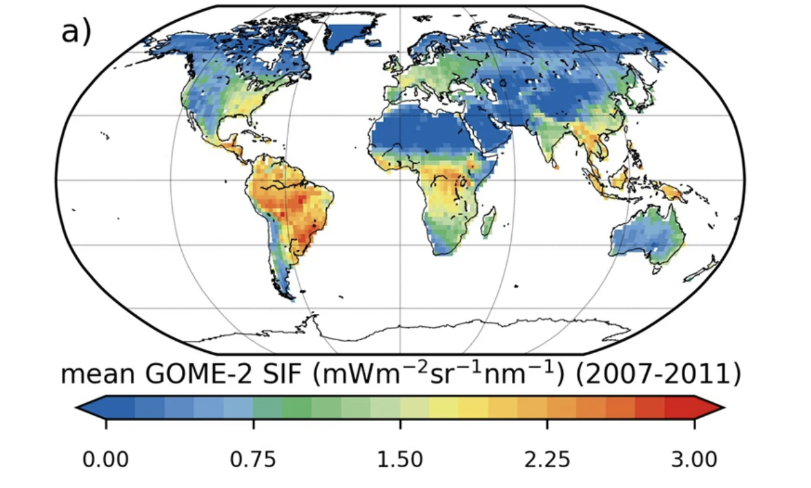
MacBean et al. 2018: Solar-Induced Fluorescence
GPP = a + b SIF

Slide 36
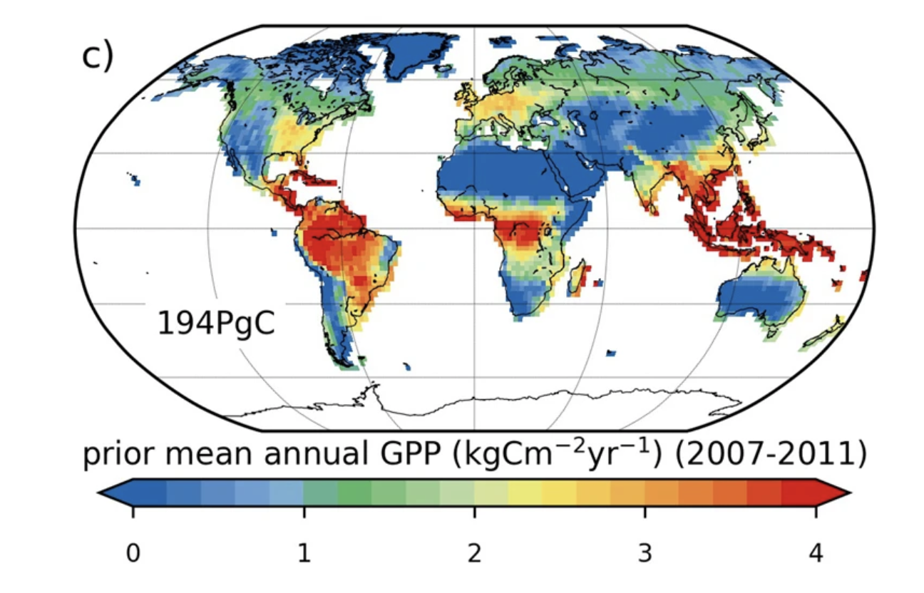
MacBean et al. 2018: Model GPP (prior)
GPP = a + b SIF

Slide 37
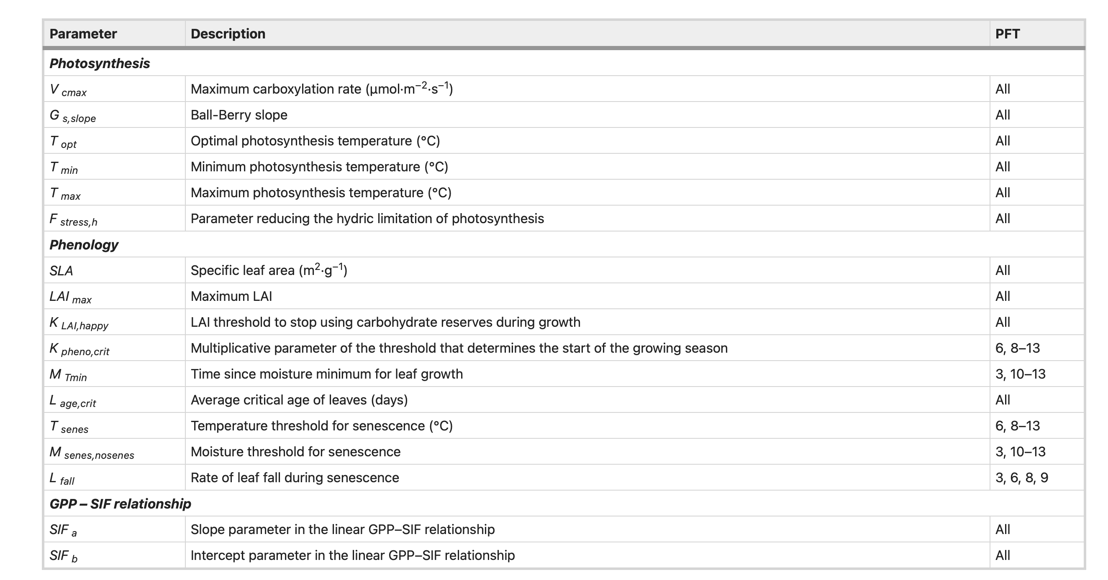

Slide 38
3DVAR
Background
J(x) = ( x-x⁻ ) P⁻¹ ( x-x⁻ )^{T} +
( y-h(x) ) R⁻¹ ( y-h(x) )^{T}
Observations

Slide 39
3DVAR
No temporal propagation of state vector
OK for zero order approximations
Unable to deal with phenology

Slide 40
4DVAR
J(x) = ( x-x⁻ ) P⁻¹ ( x-x⁻ )^{T} +
( y-h(x_{i}) ) R⁻¹ ( y-h(x_{i}) )^{T}
Σ_{i}
Time varying state vector

Slide 41
Variational techniques
Parameters constant over time window
Non smooth transitions
Assumes normal error distribution
Size of time window?
For zero-order case 3DVAR = 4DVAR
4DVAR for use with phenology model
Absence of Q - propagation of P?

Slide 42
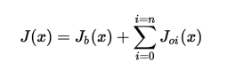
Variational data assimilation: strong constraint
Cost function minimisation
Multiple obs constraints
Plus prior
Strong constraint:
Prediction must be a valid model state
‘trust the model’

Slide 43
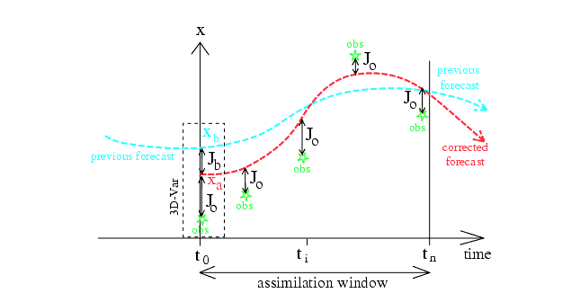
Variational data assimilation: strong constraint
Notes:
Figure from Bouttier and Courtier (1999) … should be self evident, but discuss with students. Mention 4D VAR … ie lots of these things happening over 3D space. Note that *normally* what is done is to adjust the initial conditions, eg in NWP. The ‘prior’ here is from a previous model run, or sometimes a climatology (average). Discuss advantages/disadvantages of strong constraint (trust the model … can correct for short term differences)

Slide 44
OCHIDEE with SIF
See applications of DA in notes
State-of-the-art: MacBean et al. 2018
Orchidee
French DGVM
Data for DA
GOME SIF

Slide 45
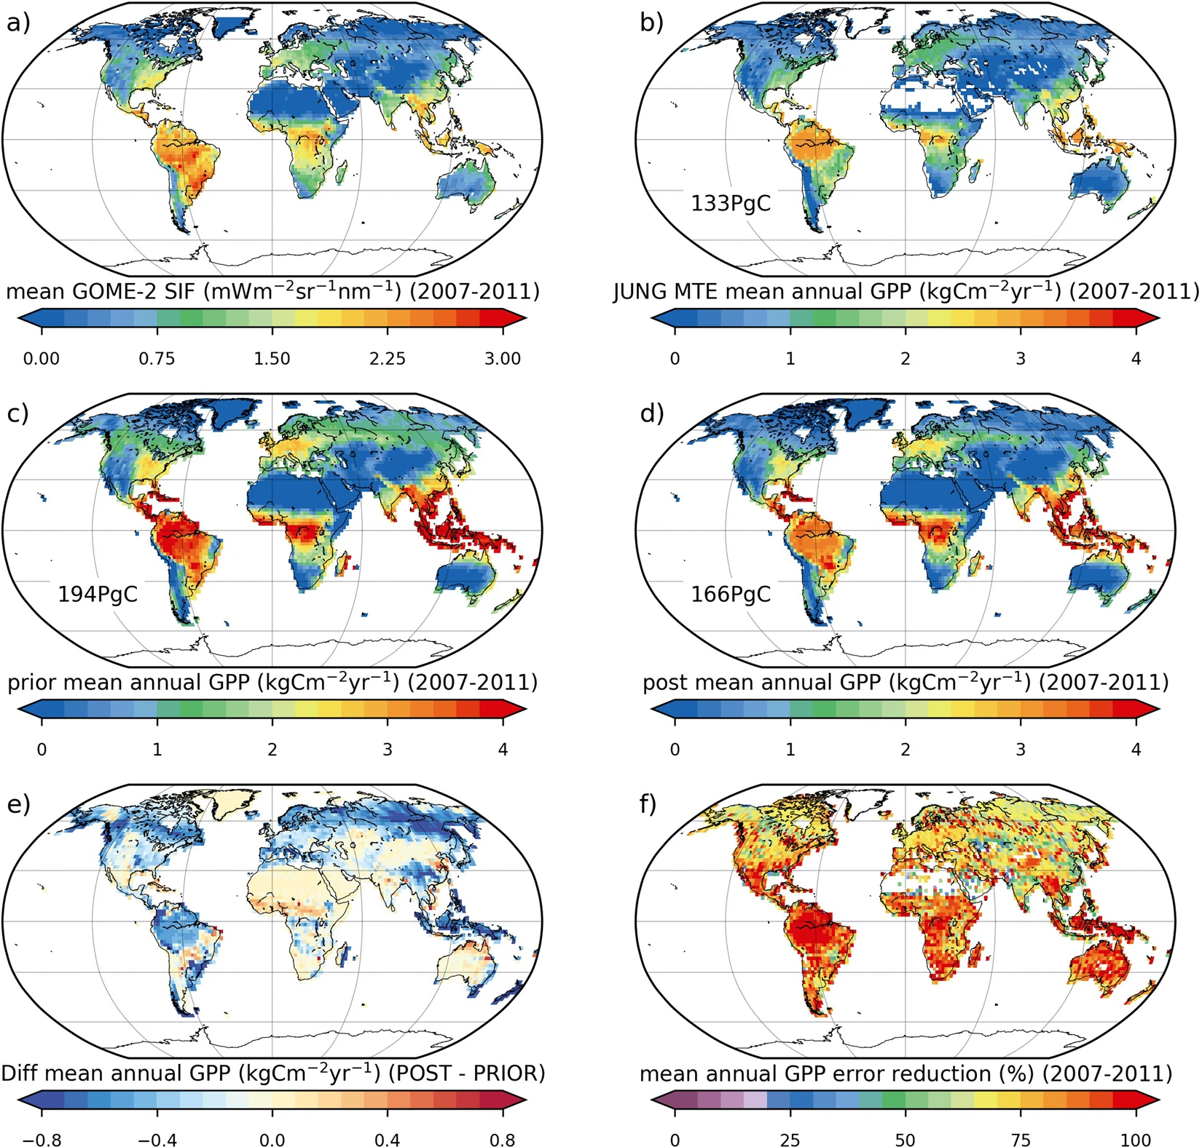
Notes:
83% reduction in GPP uncertainty

Slide 46
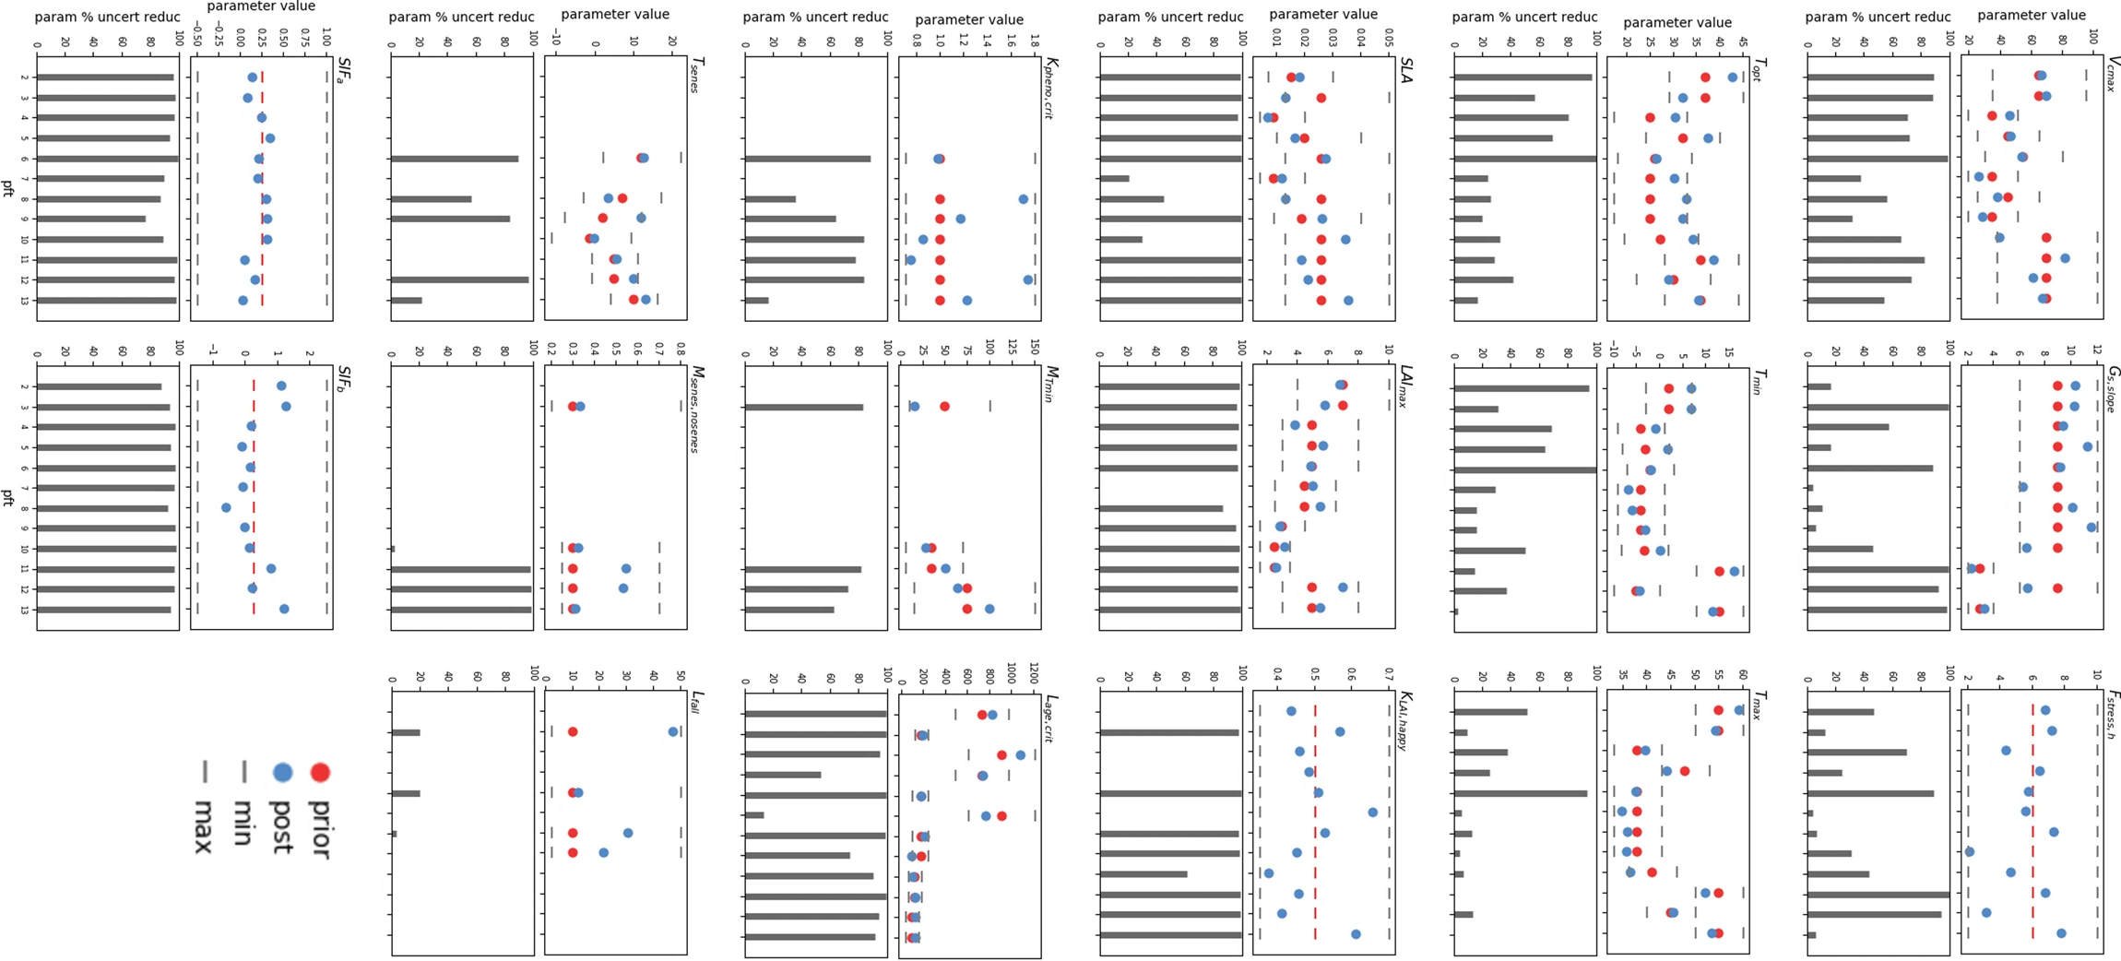
Model parameter

Slide 47
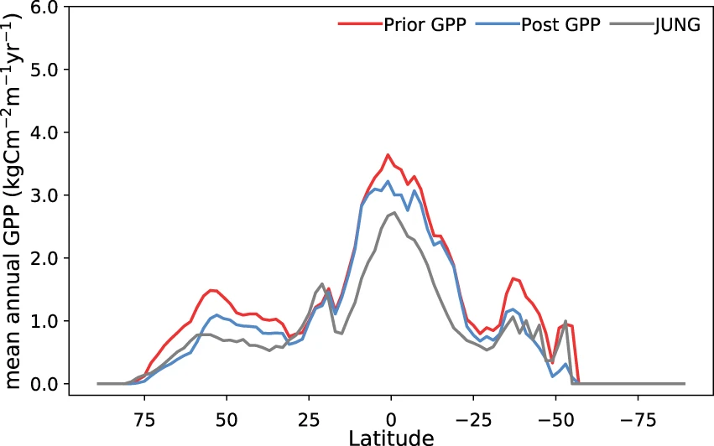
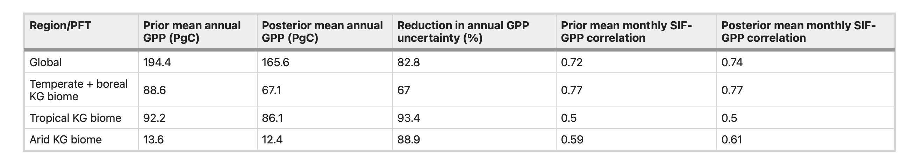

Slide 48
Data assimilation
What is DA?
What does DA do?
Examples:
Toy model
General DA concepts
Quaife et al. 2008
Sequential technique – Kalman Filter
MacBean et al. 2018 (Orchidee, SIF)
Variational technique – using cost functions

